Slide 1
Introduction to Data Science
Daniel Gutierrez, Data Scientist
Los Angeles, Calif.
Notes:
Welcome to the Introduction to Data Science course offered by UCLA Extension.

Slide 2
Course Outcomes
Ability to perform data visualization
In conjunction with EDA, be able to product simple plots involving the transformed data sets
Produce exploratory plots
Produce expository plots
Notes:
This is WEEK 8 of the Introduction to Data Science course offered by UCLA Extension. This module covers data visualization materials.

Slide 3
Lesson Objectives
Learn to use hist(), boxplot(), barplot(), density plots, scatterplots with plot(), qqplot(), heatmaps with image()
Explore big data visualization techniques: random sample, smoothscatter(), count bins with hexbin() and plot()
Techniques for additional variables: color, size of data point, plot symbols
Missing value plots
Correlation plots with pairs()
Expository plots with axis labels, legends, titles, multiple panels
Create plot PDF and image files
Notes:
The lesson objectives for WEEK 8 are to use visualization methods in support of exploratory data analysis (EDA) to become intimately familiar with a given data set.
In this module, we’ll consider a number of different plot types using the base R graphics features as shown on the slide.
Once you fully understand your data set, it is quite possible that you may need to revisit one or more data munging tasks in order to refine or transform the data even further. The goal of EDA is to obtain confidence in your data to a point where you’re ready to engage a machine learning algorithm. A side benefit of EDA is to refine your selection of features that will be used later for machine learning.

Slide 4
Data Visualization
Why do we use graphs
To understand data properties
To find patterns in data
To suggest modeling strategies
To “debug” analyses
To communicate results
Notes:
Plots constitute a significant portion of EDA activities. We use plots in EDA in order to communicate information about data in the following ways:
Understand data properties – it may be too difficult to look at the entire matrix of data for a data science project, so looking at plots is a better way of getting an overview of the data.
Find patterns in the data – you can discover new patterns and associations between variables that might have been surprising had you not been able to look at the data in graphical form.
Suggest modeling strategies – plots can inform you of the kind of modeling strategies to use.
Debug analyses – you can use plots to determine where your statistical modeling may have gone wrong. Remember, much of data science is an iterative process, so plots can lend insight for incremental steps.
Communicate results – the ability to communicate results to other people is vital to any data science project. Very often, you’ll have a story to tell immediately after performing EDA, since it is rare that anyone has taken such a deep look at the data up until that point and new insights start to emerge. “Data storytelling” is a very important part of data science, and is an area that requires a very intangible and uncommon talent from the data scientist.

Slide 5
Data Visualization
Exploratory graphs
They are made quickly
A large number are made
The goal is for personal understanding
Axes/legends are generally not cleaned up
Color/size are primarily used for information
Notes:
Exploratory plots are those that you might not necessarily save or include in a report, but, rather, they guide your hand when making early decisions about how to best use your data in machine learning and which model to use.
Exploratory graphs are done quickly, typically without regard for how they appear, as long as they’re able to communicate important information to you, the data scientist. Think of these plots as “rough drafts” for later, final analysis.
A large number of exploratory plots are made, and most will be discarded before you perform your final analysis. You make a large number of these plots to explore all of the avenues your data might take you.
The goal is for personal understanding, not necessarily communication with other people. Don’t worry about using an array of colors, titles, legends, axis labels, etc. at this point; aesthetics are not important during the exploratory stage.

Slide 6
Data Visualization
Expository graphs
The goal is to communicate information
Information density is generally good
Color/size are used both for aesthetics and communication
Expository figures have understandable axes, titles, and legends
Notes:
Expository plots are the more formal and permanent versions of the exploratory plots described above. Furthermore, this class of plots is used to communicate results to other people. It may take many iterations of exploratory plots to yield a single expository plot. While exploratory plots are used to discover hidden secrets in your data, expository plots are used to communicate the data’s story, and often find their way into the final reports and results of the data science project. Since these plots are part of the permanent record of the project, you’ll need to spruce them up with titles, labels, legends, etc. Here is a short list of goals common to expository plots:
The general goal is to communicate information.
Information density should be at a level where trying to explain the result in words would not be possible.
Size and color should be used to communicate information, but also for aesthetics.
These plots should include large, easy-to-read titles, axes and legends.

Slide 7
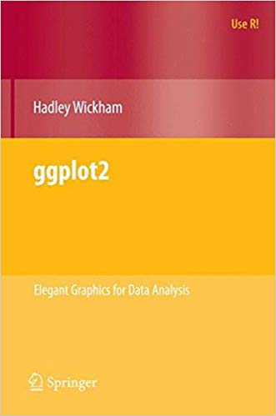
Data Visualization
Notes:
We’ll be using base R data visualization functionality in this class, but you’ll definitely want to adopt the more advanced ggplot2 package moving forward.
The book “ggplot2,” by Hadley Wickham, is the authoritative source for information about the tidyverse R package for enhanced data visualizations.

Slide 8
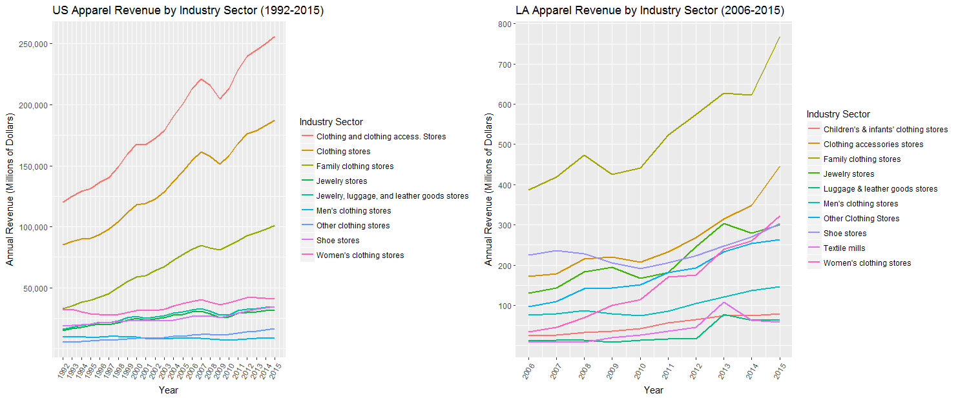
Data Visualization

Slide 9
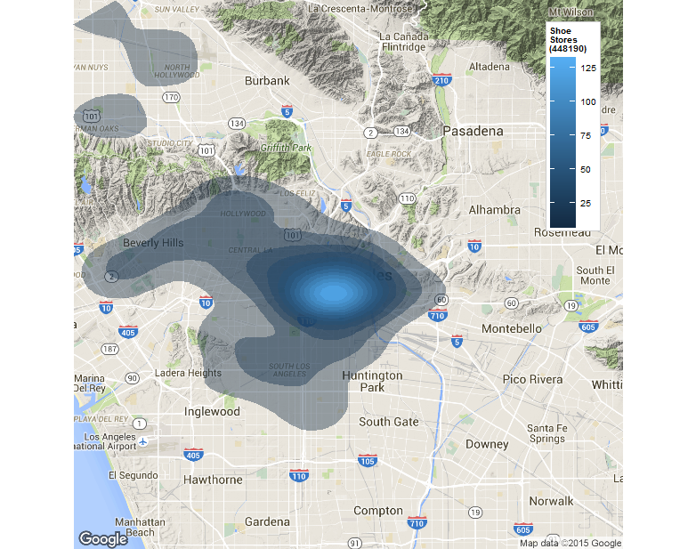
Data Visualization

Slide 10
Code modules
WEEK 8-1 Code module – Histograms
WEEK 8-2 Code module – Boxplots
WEEK 8-3 Code module – Barplots
WEEK 8-4 Code module – Density plots
WEEK 8-5 Code module – Scatterplots
WEEK 8-6 Code module – QQ-plots
WEEK 8-7 Code module – Heatmaps
WEEK 8-8 Code module – Missing value plots
WEEK 8-9 Code module – Expository plots
WEEK 8-10 Code module – Creating PDF and PNG
Notes:
In order to demonstrate the concepts for WEEK 8, we’ll step through a series of in-depth R code examples found in the Code modules listed.
I encourage you to take the R script file for WEEK 8 and try each code snippet yourself. Take some time to tweak each example and try different things so you’ll fully understand each programming concept.

Slide 11
Summary
In WEEK 8 of Introduction to Data Science, we built up our toolbox of data visualization methods in order to gain familiarity with a data set.
Now that you’ve seen base R graphics, you’ll want to explore the ggplot2 package.
The methods discussed represent a small sample of available techniques. As you progress as a data scientist, you’ll pick up more data visualization methods that will help out in this step of the data science process.
Notes:
In WEEK 8 of Introduction to Data Science we continued to build up our data science toolbox adding some valuable tools for doing data visualizations in order to gain familiarity with a data set.
We saw how to create both exploratory and expository style plots
We saw the Base R features for creating data visualizations. Now you’ll want to explore the ggplot2 package for more advanced graphics capabilities.
The methods discussed represent a small sample of available techniques. As you progress as a data scientist, you’ll pick up more data visualization methods that will help out in this step of the data science process.

